Slide 1
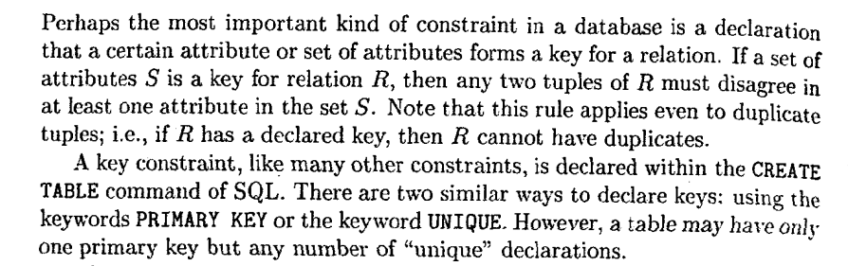
Constraints in SQL
Keys and Foreign Keys

Slide 2
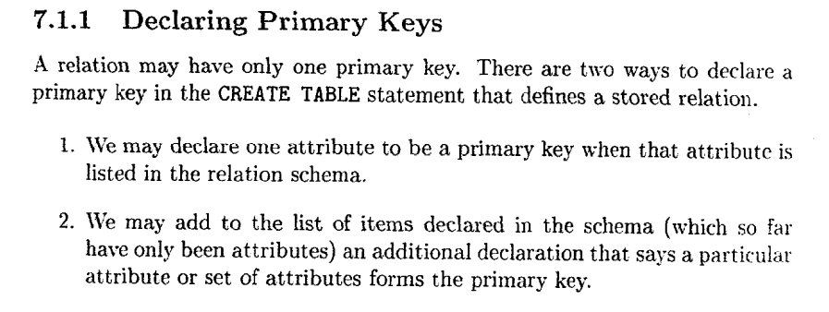
Constraints in SQL
Primary Key

Slide 3
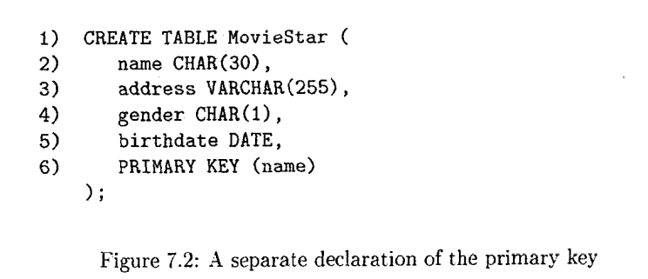
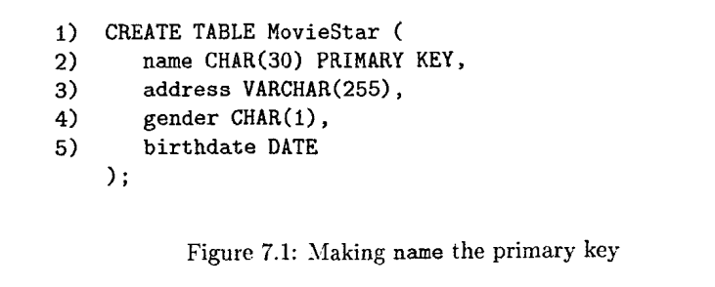

Constraints in SQL
Keys and Foreign Keys

Slide 4
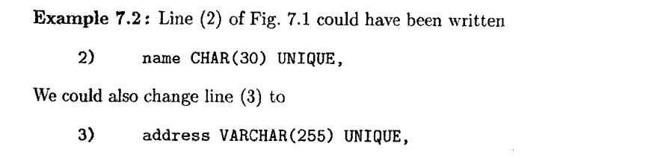

Constraints in SQL
Unique constraint
1. WE may have any number of UNIQUE declarations for a table, but only one
primary key.
2. While PRIMARY KEY forbids NULL'S in the attributes of the key, UNIQUE
permits them but no duplicate values are allowed.

Slide 5
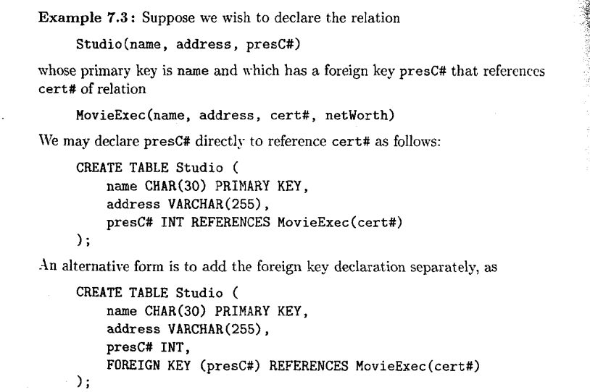
Constraints in SQL
Declaring Foreign key constraint

Slide 6
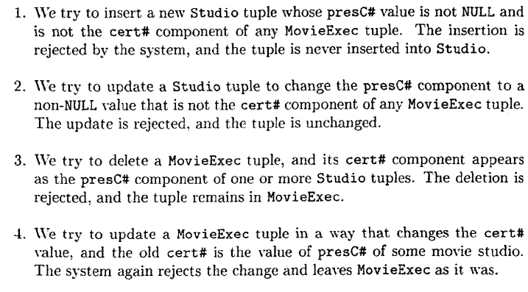
Maintaining Referential Integrity
The Default Policy: Reject Violating Modifications

Slide 7
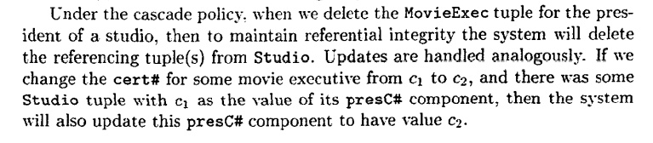
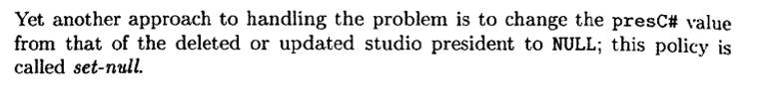

Maintaining Referential Integrity
The Cascade Policy
The Set-Null Policy

Slide 8
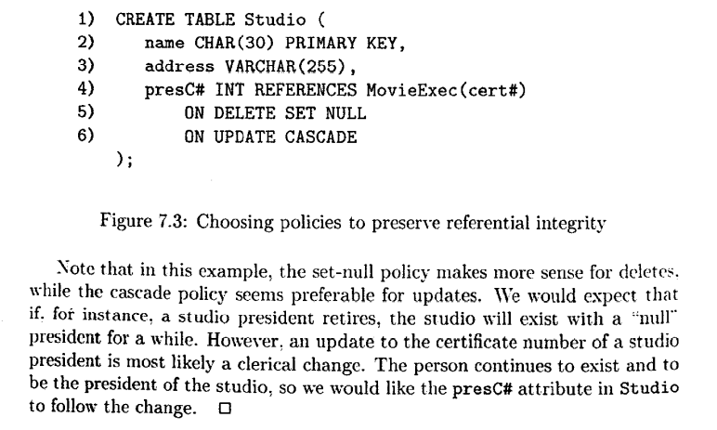
Maintaining Referential Integrity
The Cascade and Set Null Policy

Slide 9
Maintaining Referential Integrity
ON DELETE CASCADE
the referencing rows in the child table is deleted when the referenced row is deleted in the parent table which has a primary key.
ON UPDATE CASCADE
referencing rows are updated in the child table when the referenced row is updated in the parent table which has a primary key.
ON DELETE SET NULL
child data is set to NULL when the parent data is deleted. The child data is NOT deleted.
ON UPDATE SET NULL
the child data is set to NULL when the parent data is updated.

Slide 10
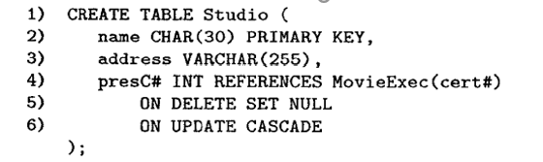
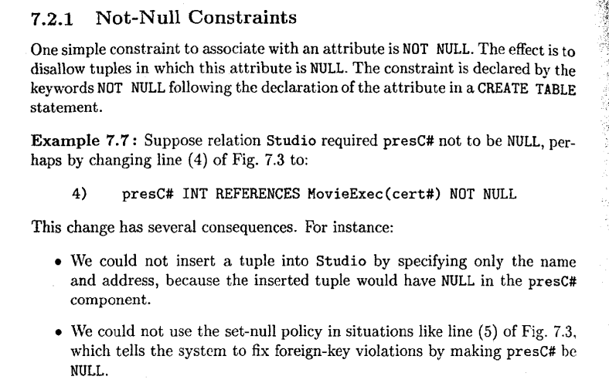
Constraints on Attributes and Tuples

Slide 11
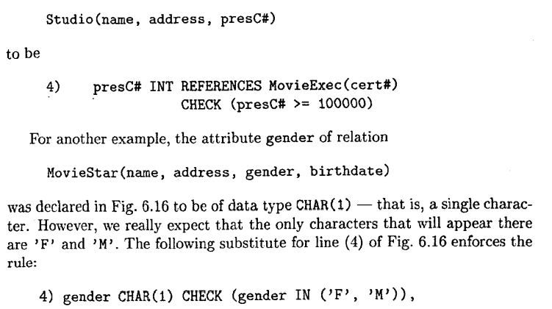
Constraints on Attributes and Tuples
Attribute based CHECK constraint
Suppose we want to require that certificate numbers be at least six digits

Slide 12
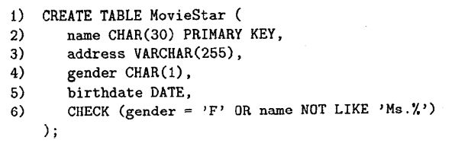
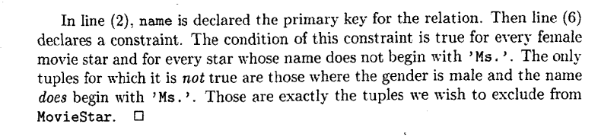
Constraints on Attributes and Tuples
Tuple based CHECK constraint
If you have a constraint that include multiple columns it will be tuple-based.
The condition of a tuple-based CHECK constraint is checked every time a tuple is inserted into R and every time a tuple of R is updated
If the condition is false for that tuple, then the constraint is violated and the insertion or update statement that caused the violation is rejected.
This constraint says that if the star's gender is male, then his name must not begin with 'Ms. '.

Slide 13
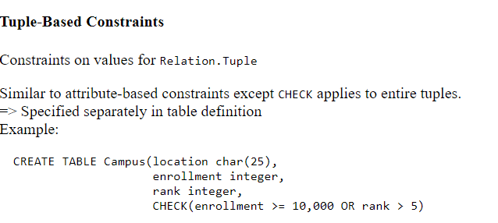
Constraints on Attributes and Tuples

Slide 14
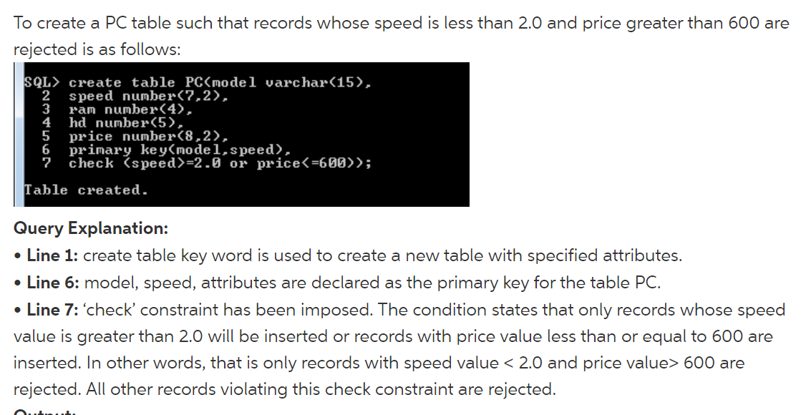
Constraints on Attributes and Tuples

Slide 15
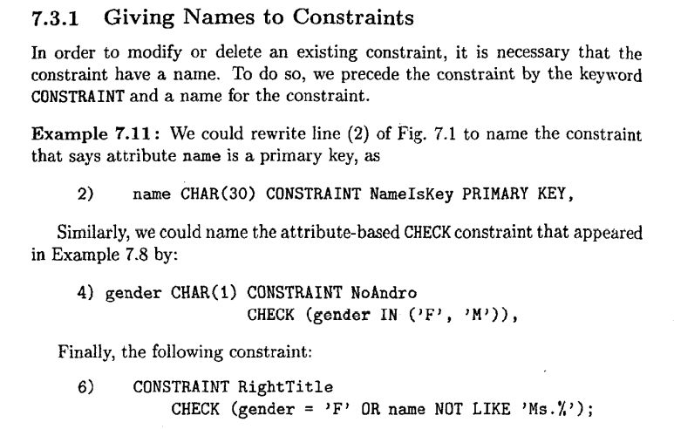
Modification of Constraints

Slide 16
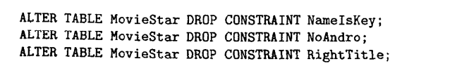
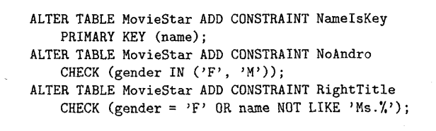
Modification of Constraints

